Slide 1
CS5112: Algorithms and Data Structures for Applications
Lecture 22: Computability; Max-flow for vision
Ramin Zabih
Some content from: Wikipedia/Google image search; Olga Veksler & Yuri Boykov

Slide 2
Administrivia
Wednesday lecture: review session
Come with questions!
Monday: final exam
Students will be assigned to the auditorium or to 071
We will let you know by email which room you are in
The following will not be on the exam
Previous lecture (SGD)
Second half of today’s lecture (max flow)
Lower bounds and approximation algorithms

Slide 3
Lecture Outline
Bad news: Some problems turn out to be impossible to solve
Uncomputable problems
Ex: determining if a hash function has collisions
Good news: Some problems are quite solvable
Binary image denoising
Max flow/min cut (“Graph cuts”)
Applications and extensions

Slide 4
The bad news
Some problems are impossible to solve
You need to be able to recognize them

Slide 5
Uncomputability
Some well-defined problems are simply impossible
No matter what your hardware, they are uncomputable
You need to be able to recognize them
Similar to NP-hardness
BUT: NP-hard problems can be solved
just not very fast

Slide 6
Halting problem
Most famous example: the halting problem
Does a particular program run forever on a specific input?
This seems easy to avoid, but…
Consider a new problem such that, if you could solve it, would allow you to solve the halting problem
There are some very subtle example of this
Just like with NP-hardness

Slide 7
When is a problem uncomputable?
This is very difficult, but there are some rules and clues
Any non-trivial property of a program is uncomputable
Rice’s theorem
Anything you can solve with exhaustive search is computable
Infinite/unbounded input is a key clue!
Small differences in problem formulation can change a computable problem into an uncomputable one

Slide 8
A children’s game
We are given blocks with symbols such as a,b,c. Each block has a top and a bottom.
There are certain types of blocks, such as a block with “ab” above “bc”.
We have as many blocks of each type as we want.
Can we find a series of blocks so that the top and bottom symbols are the same?

Slide 9
Game examples

Slide 10
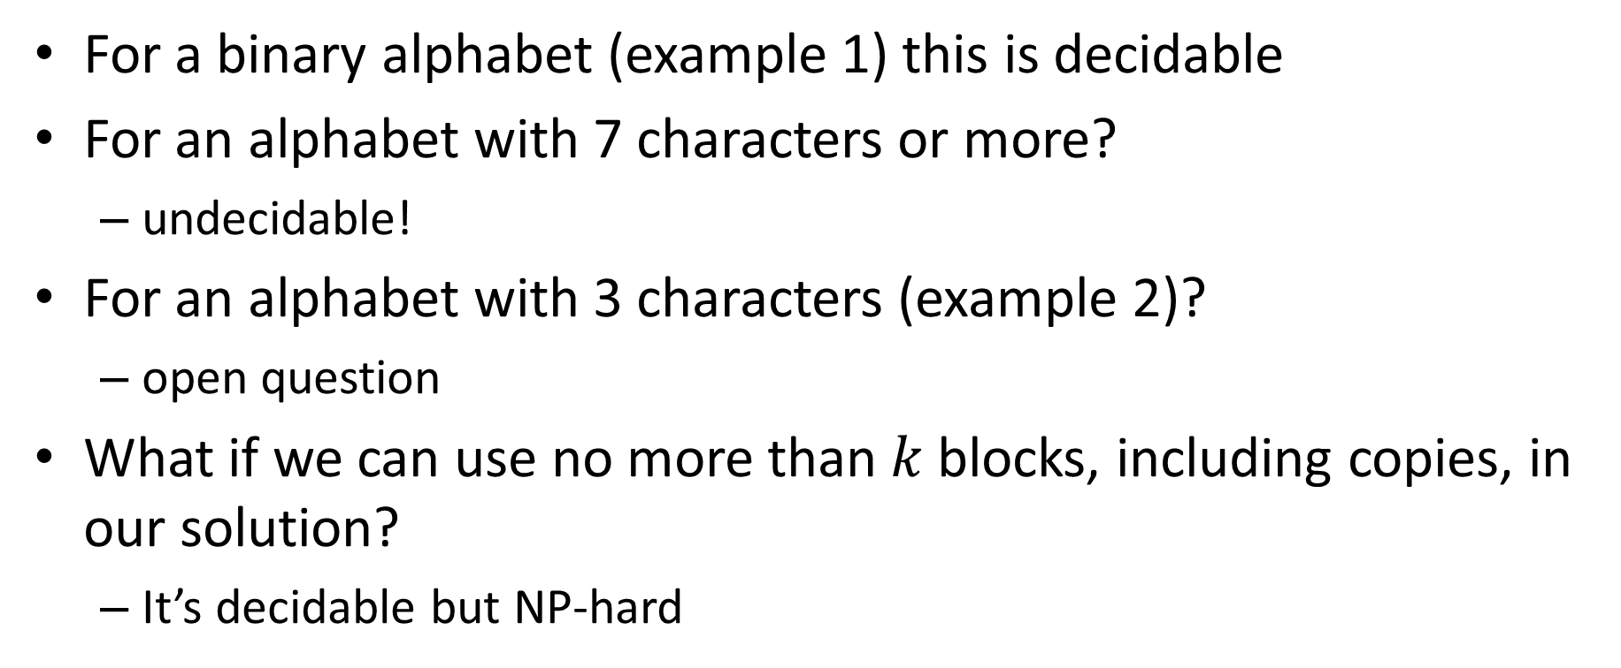
Can we solve the children’s game?
For a binary alphabet (example 1) this is decidable
For an alphabet with 7 characters or more?
undecidable!
For an alphabet with 3 characters (example 2)?
open question
What if we can use no more than$k$blocks, including copies, in our solution?
It’s decidable but NP-hard

Slide 11
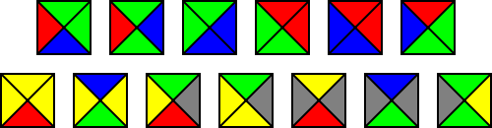
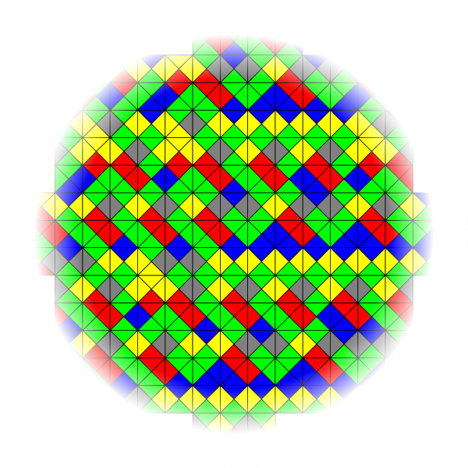
Tiling the plane
Source
Notes:
Wang tilings. Given a ‘vocabulary’ of tiles, can these be arranged to cover the whole plane? Note that there’s no obvious exhaustive (finite) solution.

Slide 12
The good news
Some challenging looking problems are solvable
Let’s start by showing off a cool vision application

Slide 13
Interactive Digital Photomontage
Aseem Agarwala, Mira Dontcheva,
Maneesh Agrawala, Steven Drucker, Alex Colburn,
Brian Curless, David Salesin, Michael Cohen
University of Washington & Microsoft Research

Slide 14
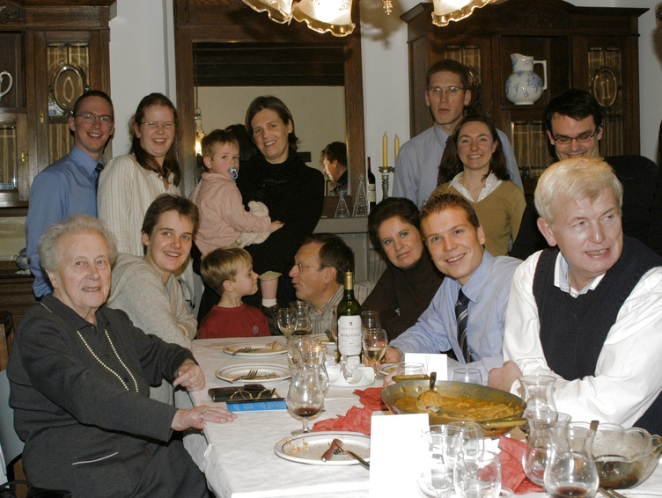

Slide 15
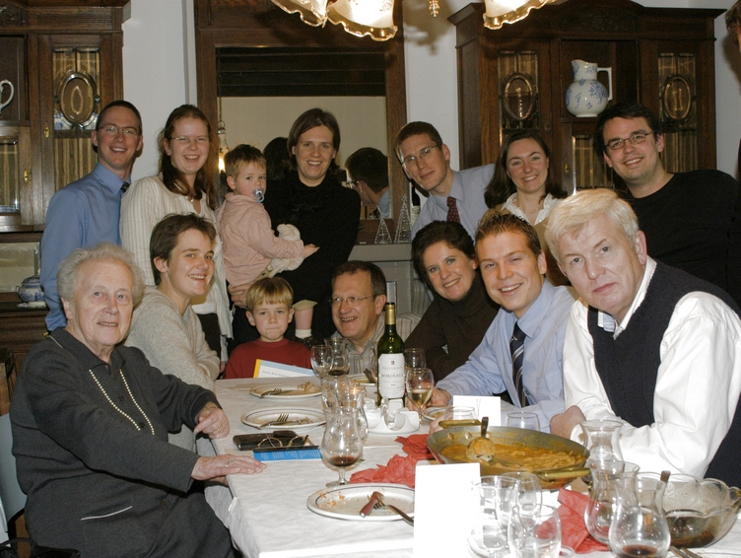

Slide 16
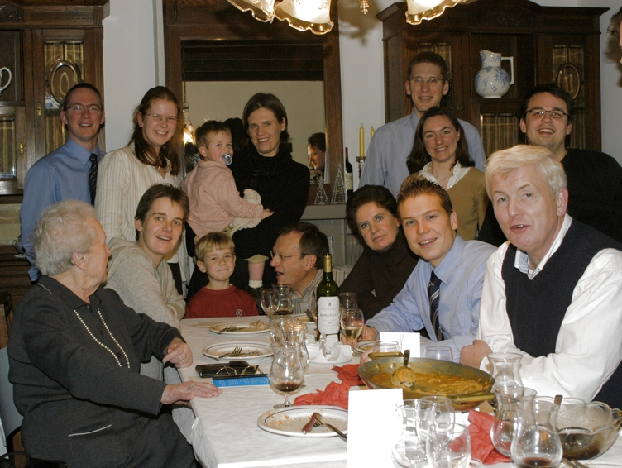

Slide 17
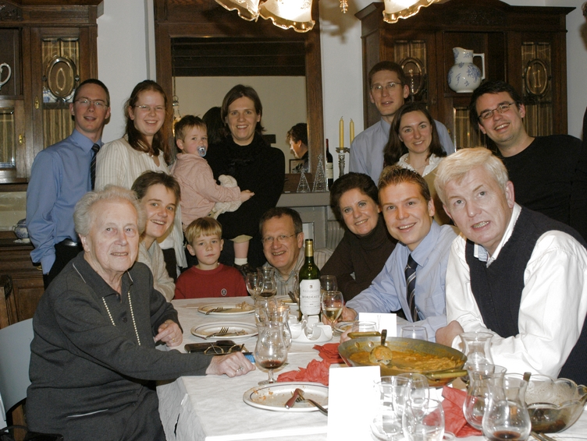

Slide 18
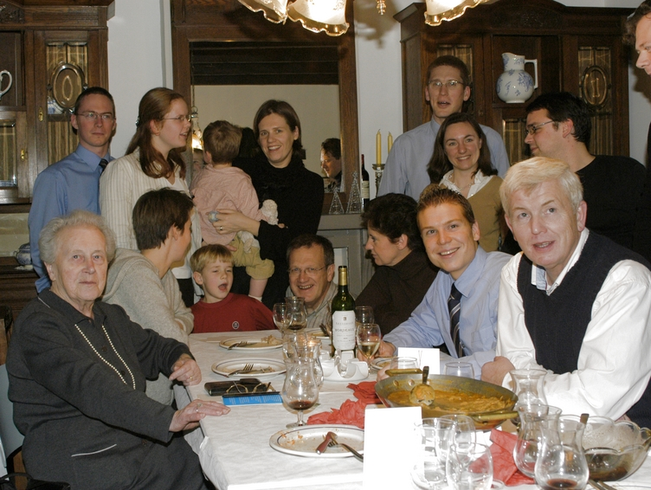

Slide 19
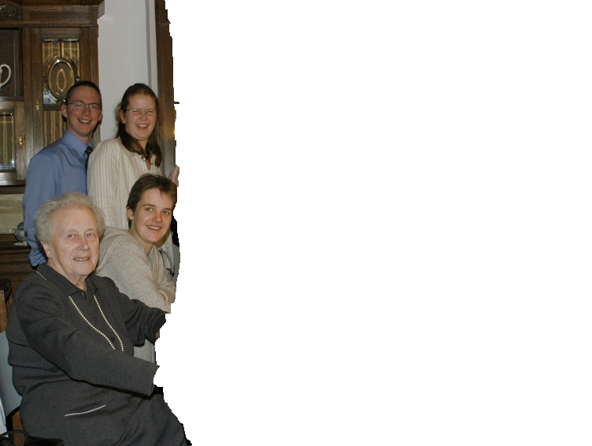
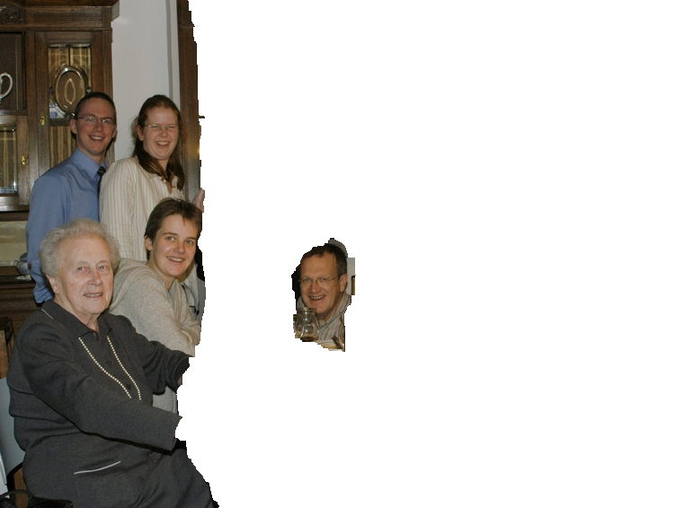
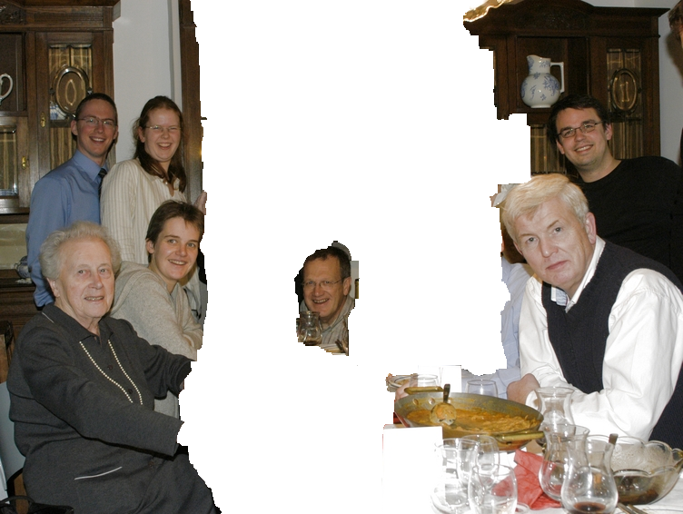
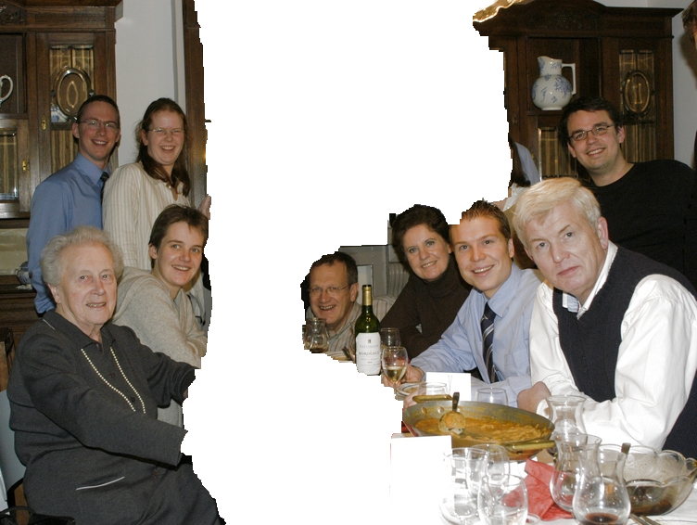
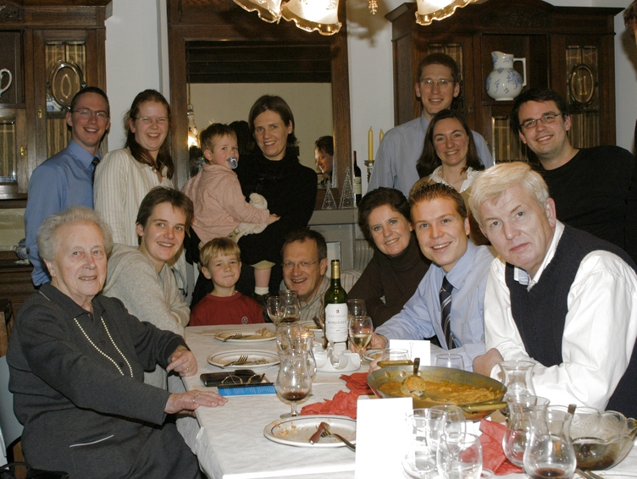

Slide 20
Image denoising
Suppose we want to find a bright object against a dark background
But some of the pixel values are slightly wrong

Slide 21
Optimization viewpoint
Find best (least expensive) binary image
Costs: C1 (labeling) and C2 (boundary)
C1: Labeling a dark pixel as foreground
Or, a bright pixel as background
If we only had labeling costs, the cheapest solution is the thresholded output
C2: The length of the boundary between foreground and background
Penalizes isolated pixels or ragged boundaries

Slide 22
Binary labeling problems
There is a natural multi-label version
But 2 labels are surprisingly important
Lots of nice applications
Same basic ideas used for more labels
Fast exact solution!
Turn a hard problem into a problem you can solve (reduction)
Due to Hammer (1965) originally
Job scheduling problems: Stone (1977)
Images: Greig, Porteus & Seheult (1989)

Slide 23
Binary Labeling: Motivation
Suppose we receive a noisy fax:
Some black pixels in the original image were flipped to white pixels, and some white pixels were flipped to black
original image
We want to try to clean up (or restore) the original image:
This problem is called image restoration (denoising)
restored image

Slide 24
Binary Labeling Problem: Motivation
Fax image is binary: each pixel is either
black (stored as 0)
or white (stored as 1)
What we know:
In the restored image, each pixels should also be either black (0) or white (1)
Data Constraint: if a pixel is black in the original image, it is more likely to be black in the restored image; and a white pixel in the original image is more likely to be white in the restored image
Prior Constraint: in the restored image, white pixels should form coherent groups, as should black pixels
original image
restored image

Slide 25
Binary Labeling Problem
We can formulate our restoration problem as a labeling problem:
Labels: black (0) and white (1)
Set of sites: all image pixels
Will use “sites” or pixels interchangeably
original image
Assign a label to each site (either black or white) s.t.
If a pixel is black (white) in the original image, it is more likely to get the black (white) label
Black labeled pixels tend to group together, and white labeled pixels tend to group together
set of sites P
, and one possible labeling

Slide 26
Binary Labeling Problem: Constraints
If a pixel is black (white) in the original image, it is more likely to get the black (white) label
Black labeled pixels tend to group together, and white labeled pixels tend to group together
original image
good labeling
bad labeling
(constraint 1)
bad labeling
(constraint 2)

Slide 27
Binary Labeling Problem: Data Constraints
How can we find a good labeling?
i.e., satisfying our constraints
Formulate and minimize an energy function on labelings L:
Let L_{p} be the label assigned to pixel p
L_{p} = 0 or L_{p} = 1
Let I(p) be the intensity of pixel p in the original image
Data constraint is modeled by the Data Penalty D_{P}(L_{P})
D_{P}(0) < D_{P}(1) if I(p) = 0
D_{P}(0) > D_{P}(1) if I(p) = 1
original image
a good labeling L

Slide 28
Binary Labeling Problem: Data Constraints
In our example, we can make
if I(p) = black then
D_{P}(black) = 0
D_{P}(white) = 4
if I(p) = white then
D_{P}(black) = 4
DP(white) = 0
original image
To figure out how well image as a whole satisfies the data constraint, sum up data terms over all image pixels:
a good labeling L

Slide 29
Binary Labeling Problem: Prior Constraints
To model our prior constraints, simply count the number “discontinuities” in a labeling L:
There is a discontinuity between pixels p and q if labels p and q have different labels
The more pixels with equal labels group together in coherent groups, the less discontinuities there are
some discontinuities
are marked
all discontinuities
are marked
31 discontinuities
8 discontinuities

Slide 30
Binary Labeling: Data Constraints
How to count the number of discontinuities in a labeling L?
Let N be the set of all adjacent pixels
Thus our N consists of edges between immediately adjacent pixels
Let I(b) be the identity function
I(b) =1 when its argument b is true
I(b) =0 when its argument b is false
N consists of all edges
To count all discontinuities in a labeling L,
31 discontinuities

Slide 31
Binary Labeling Problem: Energy Formulation
Our final energy, which takes into consideration the data and the prior constraints is:
data term
prior term
Data term says that in a good labeling L pixels should be labeled as close as possible to their colors in the original (noisy) image
Prior term says that in a good labeling L pixels should be labeled as to form spatially coherent blocks (as few discontinuities as possible)

Slide 32
Binary Labeling Problem: Energy Formulation
data term
prior term
Note that data term and prior term want different things:
Best labeling as far as the data term is concerned is the original image:
Best labeling considering only the prior term is completely black or completely white:

Slide 33
Binary Labeling Problem: Energy Formulation
data term
prior term
λ serves as a balancing parameter between the data term and the prior term:
The larger the λ, the less discontinuities in the optimal labeling L
The smaller the λ, the more the optimal labeling L looks like the original image
λ=0
λ=huge number

Slide 34
The Hard Computational Problem
data term
prior term
Now that we have an energy function, the big question is how do we minimize it?
Exhaustive search is exponential: if n is the number of pixels, there are 2^{n} possible labelings L

Slide 35
Graph Cuts for Binary Energy Minimization
Can minimize this energy exactly with graph cuts!
Build a graph with 2 terminals s,t
Image pixels are nodes in the graph
t
n-links
a cut
nearby pixels(nodes) connected by an edge, which we call n-link
Terminal s is identified with label 0, and connected by edge called t-link with every image pixel
t-link
t-link
Terminal t is identified with label 1and connected by edge called t-link with every image pixel
s
A cut separates t from s
Each pixel stays connected to either t or s (label 1 or 0)

Slide 36
Graph Cuts for Binary Energy Minimization
Build a graph with 2 terminals s,t
Image pixels are nodes in the graph
nearby pixels(nodes) connected by an edge, which called an n-link
Terminal s is identified with label 0, and connected by edge called t-link with every image pixel
Terminal t is identified with label 1and connected by edge called t-link with every image pixel
A cut separates t from s
Each pixel stays connected to either t or s
If pixel p stays connected to terminal s, assign label 0 to p
If pixel p stays connected to terminal t, assign label 1 to p
Cuts correspond to labelings, and with right edge weights cost is same
Thus the minimum cut gives the minimum energy labeling

Slide 37
Example
For clarity, let’s look at 1 dimensional example but everything works in 2 or higher dimensions. Suppose our image has 4 pixels:
p
q
r
s
We build a graph:
The cut in red corresponds to labeling
black
0
p
q
r
s
The cut in green corresponds to labeling
1
white

Slide 38
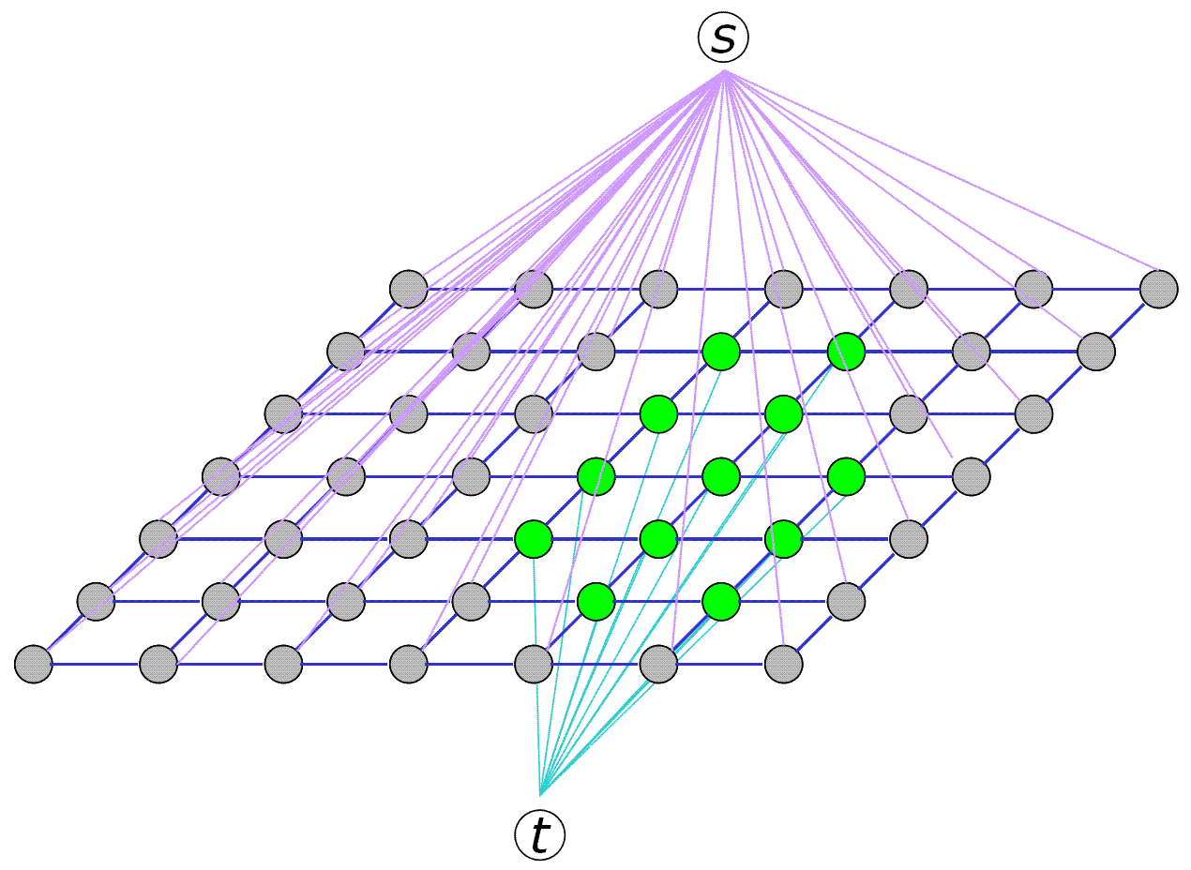
Graph construction

Slide 39
Beyond binary faxes
All we really need is a cost function
Suppose that label 1 means “foreground” and label 0 means “background”
How do we figure out if a pixel prefers to be in the foreground or background?
Predefined intensities: for instance, the foreground object tends to have intensities in the range 50-75
So if we observed an intensity in this range at p, D_{p}(1) is small
This is not image thresholding!

Slide 40
Better intensity models
We can compute the range of intensities dynamically rather than statically
Both for foreground and for background
User marks some pixels as being foreground, and some as background
Compute a D_{p} based on this
For instance, D_{p}(1) is small if p looks like pixels marked as being foreground
Based on the resulting segmentation, mark additional pixels

Slide 41
A serious implementation
This basic segmentation algorithm is now in Microsoft office
SIGGRAPH paper on “GrabCut”
Same basic idea, but simpler UI
Assume the background is outside and the foreground is inside a user-supplied box
D_{p}(1) is small if p looks like the pixels inside the box, large if like the pixels outside
Create a new segmentation and use it to re-estimate foreground and background

Slide 42









GrabCut
Notes:
Here are some images from my last hiking trip in England. And would it be great if we could just do the following. Drag rectangle. Create a nice photomontage with an extreamly simple user interface.

Slide 43



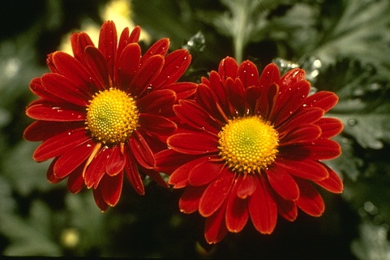

Iterated Graph Cuts
Guaranteed to converge
1
2
3
4
Result
See: http://www.youtube.com/watch?v=9jNB6fza0nA&feature=related
Notes:
Iterations are not shown to the user; Converges: proof in the paper.

Slide 44
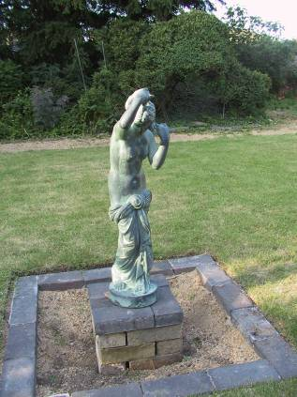
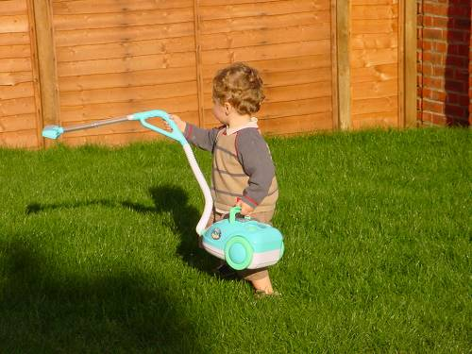

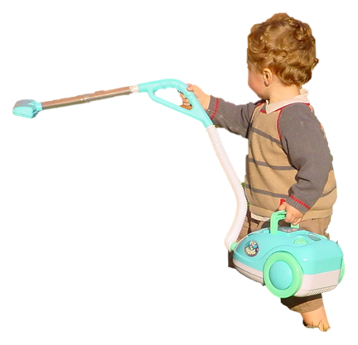


Moderately straightforward examples
… GrabCut completes automatically
Notes:
Moderately straightforward examples- after the user input automnatically

Slide 45
Can this be generalized?
NP-hard for Potts model
Two main approaches
1. Exact solution [Ishikawa 03]
Large graph, convex V (arbitrary D)
Not the considered the right prior for vision
2. Approximate solutions
Solve a binary labeling problem, repeatedly
Expansion move algorithm

Slide 46
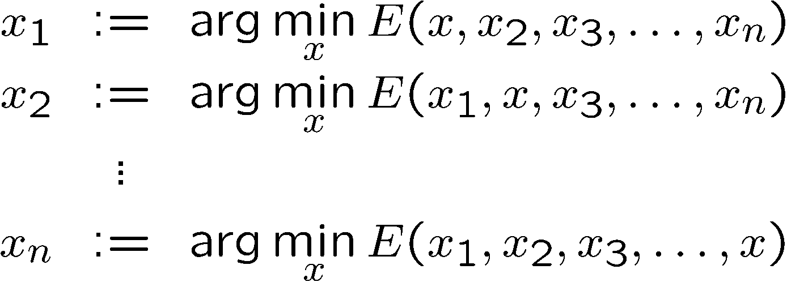
Coordinate descent (local improvement)
Subproblem: pick a pixel, find the label that minimizes E, repeat
Minimize restricted version of E (line search)
Computes a local minimum

Slide 47
Swap moves and expansion moves
Red-blue swap move
Starting point
Green expansion move

Slide 48








Expansion moves in action
initial solution
-expansion
-expansion
-expansion
-expansion
-expansion
-expansion
-expansion
For each move we choose expansion that gives the largest decrease in the energy: binary energy minimization subproblem

Slide 49
Important properties
Very efficient in practice
Lots of short paths, so roughly linear
Construction is symmetric (0 vs 1)
Specific to 2 labels
Min cut with >2 labels is NP-hard

Slide 50
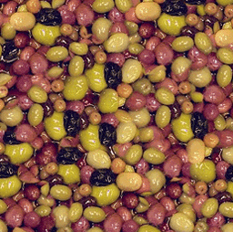
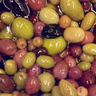
Application: texture synthesis
B
A
C
D
A
B
C
D
F
E
G
E
F
G
H
I
J
H
I
J
“Graphcut textures” [Kwatra et al 03]

Slide 51


Graphcuts video textures
a cut
1
2
Short video clip
Long video clip

Slide 52

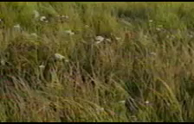
Another example
original short clip
synthetic infinite texture

Slide 53




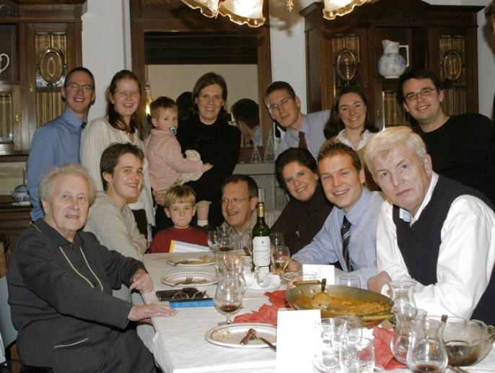
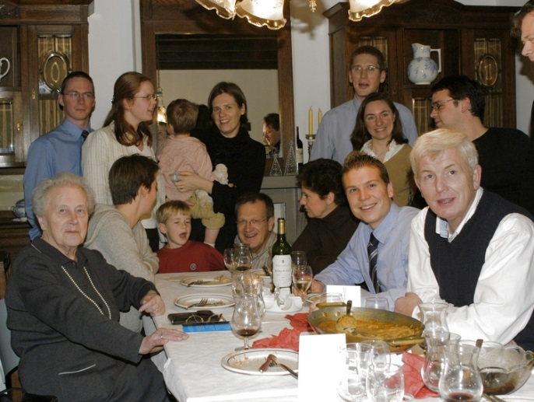
perceived
set of originals
photomontage
actual
Notes:
When we take a photograph of a group of people, such as this image on the left, what we get is a frozen moment of time that is often less natural, and less attractive than the scene we remember. This is because the cognitive processes that form our visual memories integrate over a range of time to form a subjective impression. This memory will likely look a lot more like the image on the right, where everyone is smiling naturally.
The goal of our photomontage system is to help us create photographs that better match the image we see in our mind’s eye. To do so, we begin with a stack of images, and combine the best parts of each to form an image that is better than any of the originals.

Slide 54
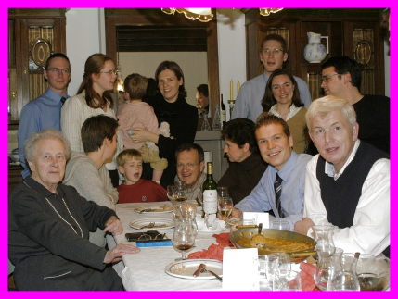
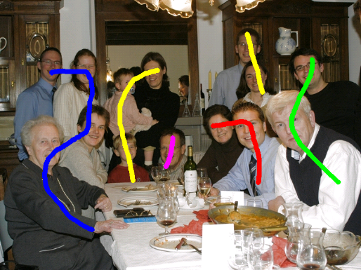
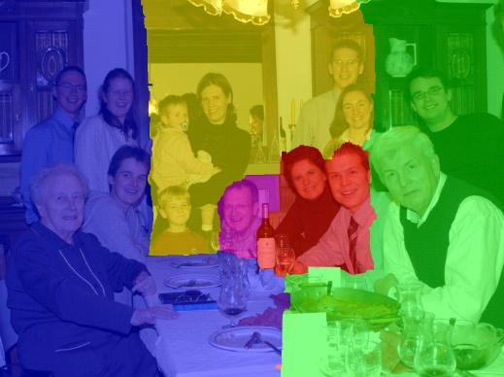
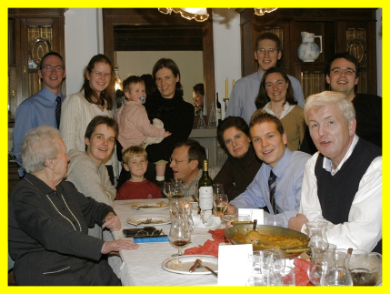
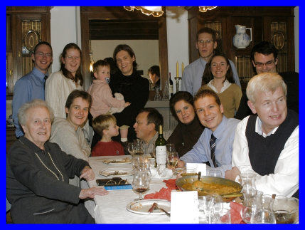
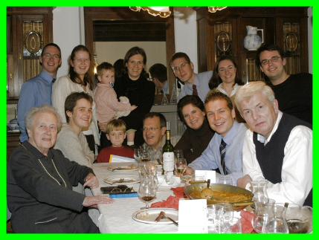
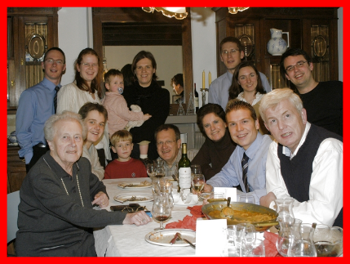
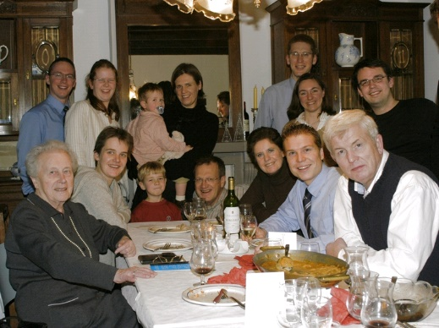
Source images
Brush strokes
Computed labeling
Composite

Slide 55
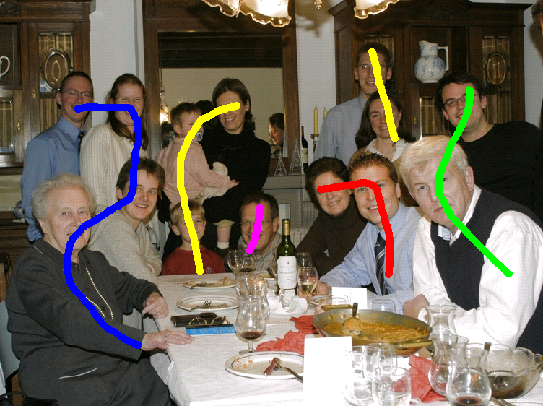

Brush strokes
Computed labeling

Slide 56


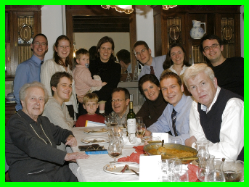



Image objective
0 for any label
0 if red
∞ otherwise

